Slide 1

Smart Dermatology Assistant using AI and Image Processing ITA0506-Computer Vision
Presented by:
R.Sushma(192525279)
K.Sandhya(192472207)
S.Vyshnavi(192472041)
Logesh.S(192525023)
Gunalan.V(192325038)
Under the guidance by:
Program Director:Dr.Sasi Rekha,Prof/CSE
Faculty:Dr. R.C.Jeni Gracia,AP/CSE

Slide 2


AGENDA
Agenda
Intrduction
Literature Review
Objectives
System Architecture
Modules
Results and Discussion
Application
Conclusion
References

Slide 3
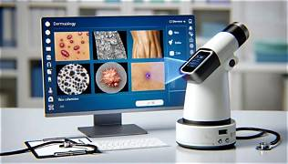
INTRODUCTION
Skin problems are common, and it can be difficult to know what the problem is by looking at it.
The system uses AI to check the uploaded skin image and find possible skin problems.
Image processing improves the image and helps the system clearly understand the skin condition.
The system can identify common problems like acne, rashes, redness, dark spots, and other skin changes.
The system gives simple information about the detected skin problem.
It provides results quickly and makes the system easy for users to use.

Slide 4


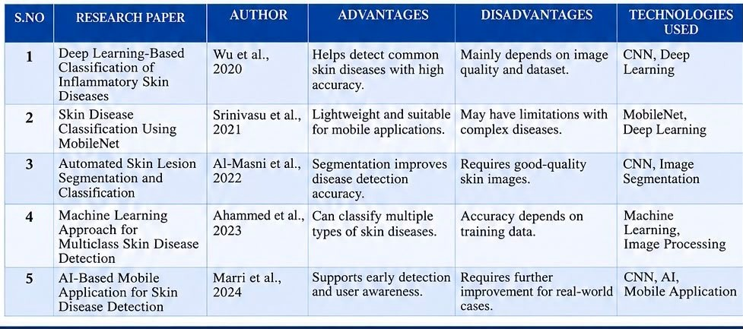
LITERATURE SURVEY

Slide 5
PROBLEM STATEMENT
Skin disease diagnosis is mainly performed through manual visual inspection.
Diagnosis accuracy depends on the dermatologist's experience and expertise.
Manual examination is time-consuming and may delay treatment.
Early-stage skin diseases can be difficult to identify accurately.
Existing systems lack automated AI-based disease detection.
Severity of skin diseases is not assessed consistently.

Slide 6
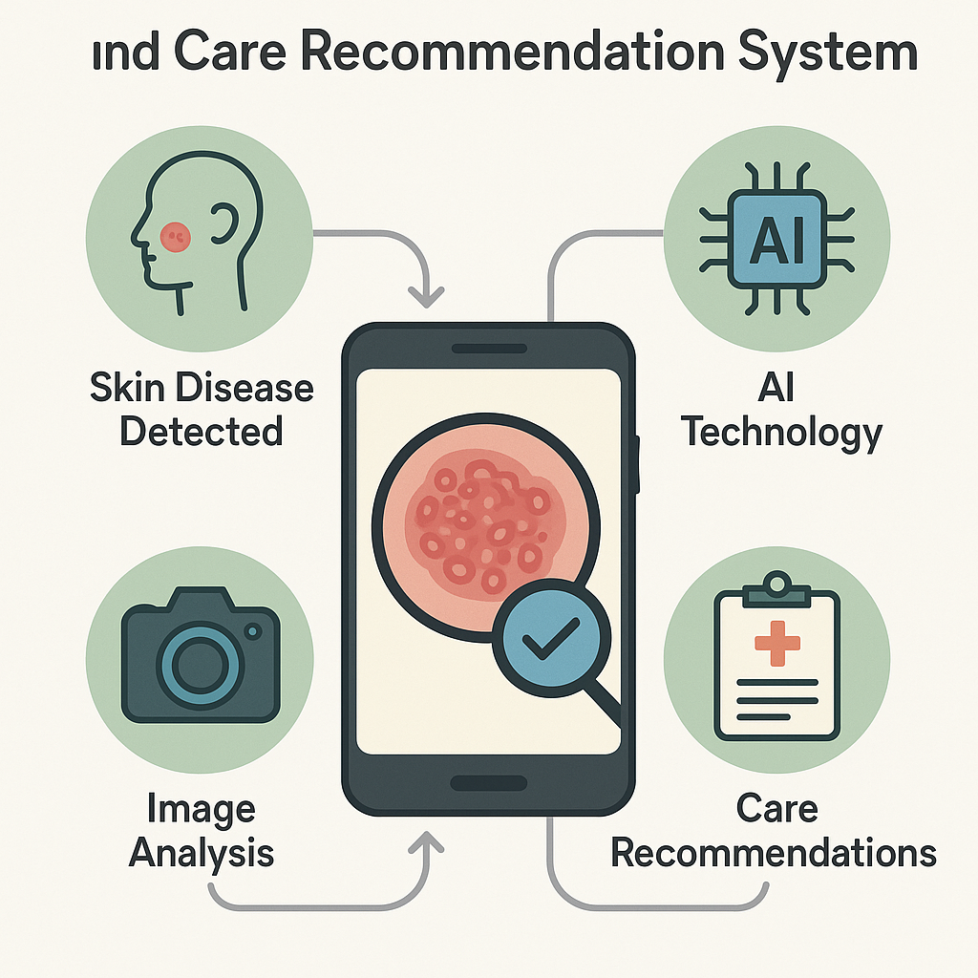
OBJECTIVES
To develop an AI-based system for automatic skin disease detection
To analyze skin images using image processing techniques
To accurately classify common skin diseases using CNN models
To provide basic care, treatment, and preventive recommendations
To assist in early diagnosis and support remote healthcare services

Slide 7
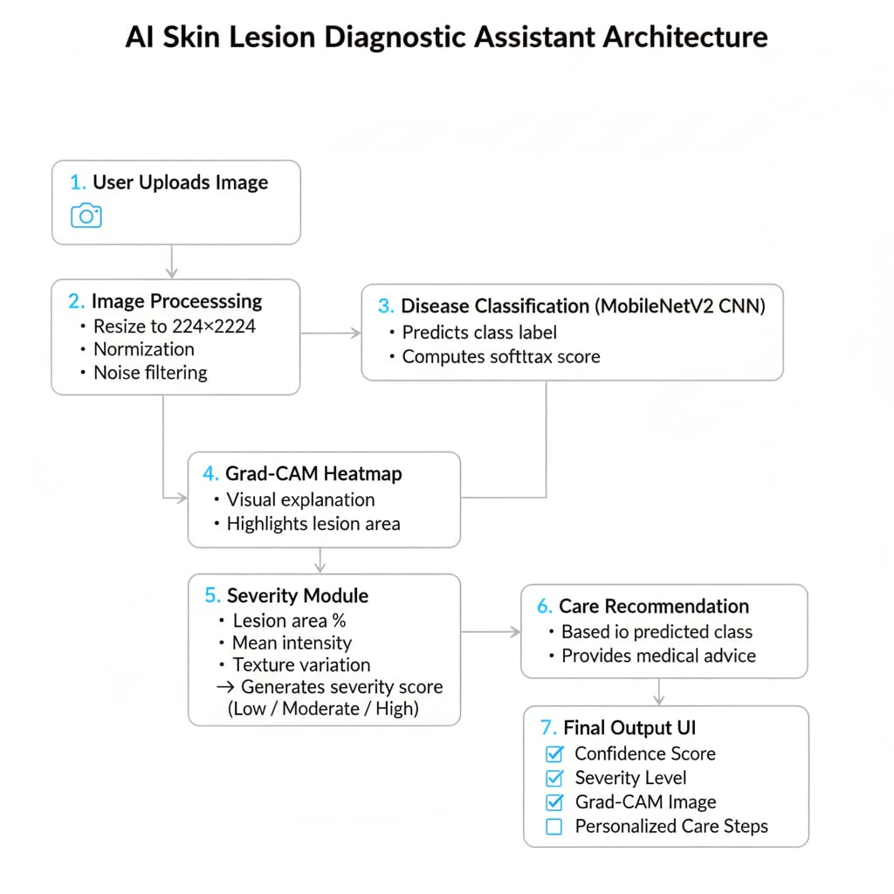
ARCHITECTURE DIAGRAM

Slide 8
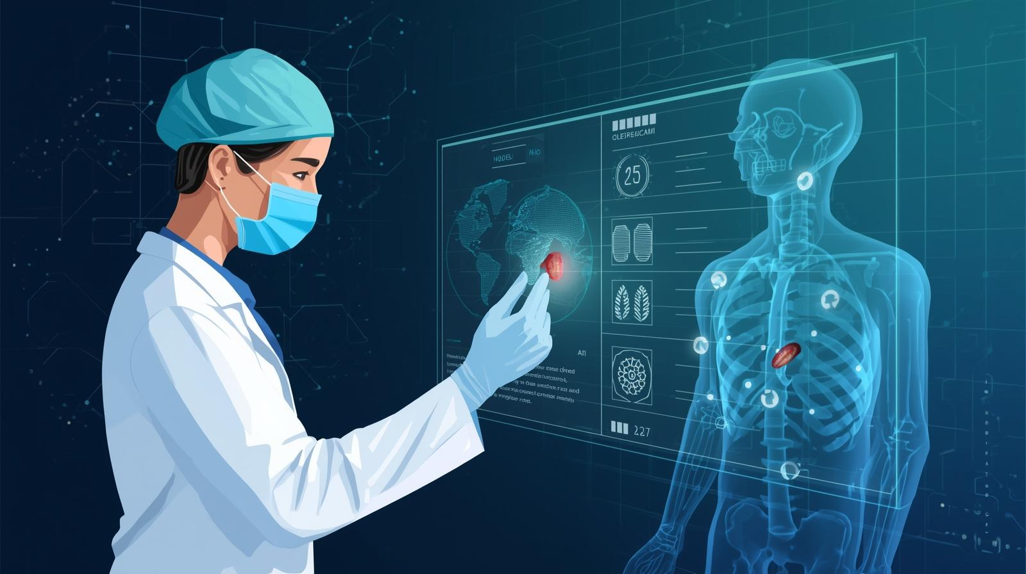
Module 1: Skin Disease Detection using AI & Image Processing
We collected different types of skin disease images for training the model.
The images were cleaned and resized using preprocessing techniques.
We used the MobileNetV2 deep learning model to detect skin diseases.
The model studies color, texture, and shape of the skin lesion.
It gives the disease name and prediction result for further analysis.

Slide 9
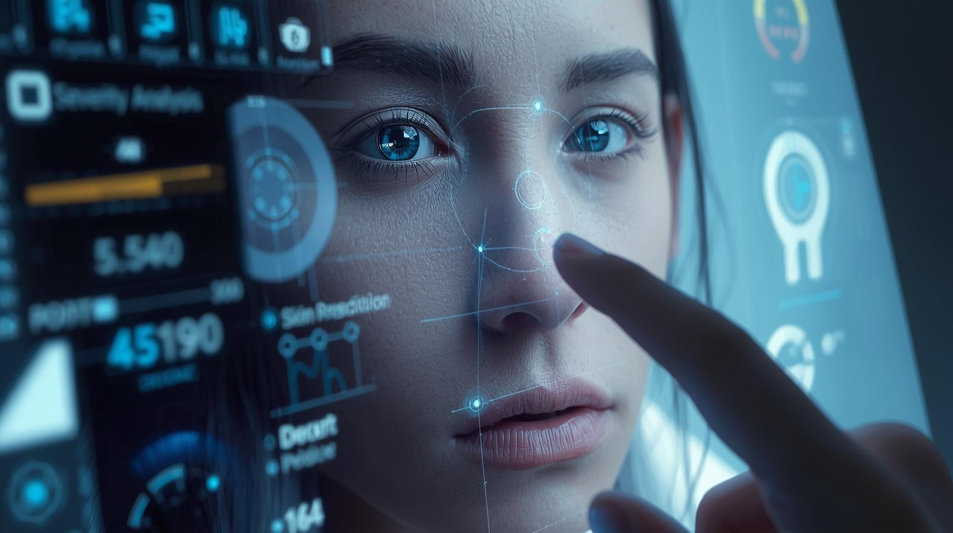
Module 2: Severity Analysis & Risk Level Prediction
Checks how serious the skin problem is by analyzing the uploaded skin image.
Examines important signs such as redness, spots, swelling, size, and affected area.
Measures how much the skin problem has spread in the affected area.
Classifies the condition into severity levels such as Mild, Moderate, or Severe.
Predicts the risk level as Low, Medium, or High to help the user understand the condition.
Provides a clear result and suggests whether medical consultation may be needed.

Slide 10
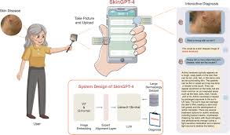
Module 3: Care Recommendation & Preventive Guidance System
Built a rule-based system to suggest care based on disease type.
Gave medically accurate home-care tips and safety precautions.
Suggests doctor consultation when needed.
Recommended dermatologist visits for moderate and severe cases.
Provided simple, clear guidance for patients to follow easily.

Slide 11
Module 4: Explainable AI (Grad-CAM) Visualization
Applied Grad-CAM to visualize the regions of the skin image that influenced the AI model's prediction.
Generated heatmaps highlighting the affected lesion areas.
Improved transparency and reliability of the deep learning model.
Helped users and doctors understand why a particular disease was predicted.
Increased confidence in AI-assisted diagnosis.

Slide 12
Module 5: Report Generation & Patient History Management
Generated a comprehensive report containing disease name, confidence score, severity level, and care recommendations.
Stored patient details and prediction history for future reference.
Allowed comparison of previous and current skin conditions.
Supported monitoring of disease progression over time.
Enabled easy sharing of reports with healthcare professionals.

Slide 13
CONCLUSION
Smart system enables early and accurate detection of skin diseases
Uses AI and image processing to reduce manual diagnosis errors
Provides basic care, treatment, and prevention recommendations
Saves time and cost by reducing frequent hospital visits
Supports remote healthcare and improves skin health awareness

Slide 14
FUTURE SCOPE
Improve accuracy using advanced deep learning and larger datasets
Support detection of a wider range of skin diseases, including rare conditions
Integrate with mobile apps and cloud platforms for real-time analysis
Enable direct online consultation with dermatologists
Add multilingual support and personalized treatment recommendations

Slide 15


REFERENCES
ISIC Archive (2020–2024). International Skin Imaging Collaboration Dataset. Available online: https://www.isic-archive.com
Wu, X., Xu, Y., & Liu, J. (2020). Deep learning-based classification of inflammatory skin diseases using clinical images. IEEE Access.
Srinivasu, P. N., et al. (2021). Skin disease classification using MobileNet and deep learning techniques. Sensors.
Al-Masni, M., et al. (2022). Automated skin lesion segmentation and classification using deep CNN models. ISIC Dataset Studies.
Ahammed, S. S., et al. (2023). Machine learning approach for multiclass skin disease detection. Healthcare Analytics Journal.

Slide 16


